Slide 1
Chapter 2
Understanding the Human Body

Slide 2
Body Systems
Regulate breathing and heart rate
If one fails, an emergency can occur.
Basic life support (BLS) helps sustain life following system failure.

Slide 3
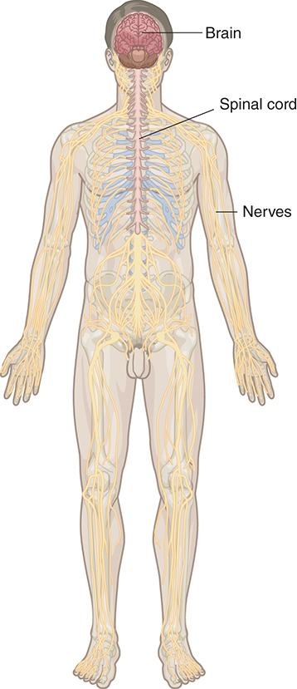
The Nervous System (1 of 2)
Command center of the human body
The brain and spinal cord are the headquarters and communication system for the body.
© Jones & Bartlett Learning.

Slide 4
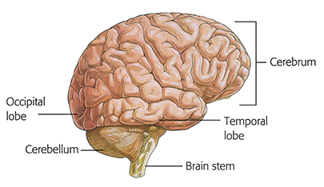
The Nervous System (2 of 2)
The brain is particularly sensitive to oxygen deprivation.
Determine the patient’s normal level of consciousness whenever possible.
© Jones & Bartlett Learning.

Slide 5
The Respiratory System (1 of 3)
Delivers oxygen to the lungs
Removes waste products
Must function continuously or the brain will die within minutes
Begins at the nose and mouth
Ends at the alveoli of the lungs

Slide 6
The Respiratory System (2 of 3)
© Jones & Bartlett Learning.

Slide 7
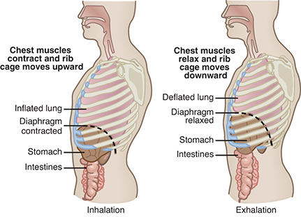
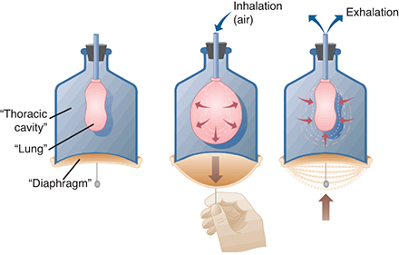
The Respiratory System (3 of 3)
Normal respiratory rates
Adults: 12 to 20 breaths per minute
Children: 12 to 40 breaths per minute
Infants: 30 to 60 breaths per minute
© Jones & Bartlett Learning.
© Jones & Bartlett Learning.

Slide 8
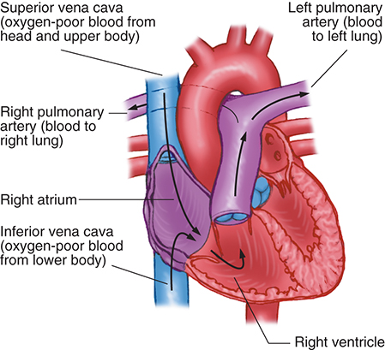
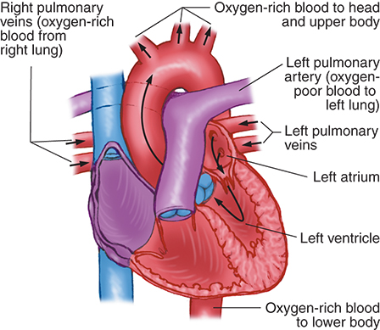
The Circulatory System (1 of 3)
Made up of heart and blood vessels
Circulates blood
Delivers oxygen and nutrients
Removes waste products
© Jones & Bartlett Learning.
© Jones & Bartlett Learning.

Slide 9
The Circulatory System (2 of 3)
Each heartbeat circulates blood and generates a pulse.
Check the pulse of an
Unresponsive adult or child at the carotid artery
Infant at the brachial artery

Slide 10
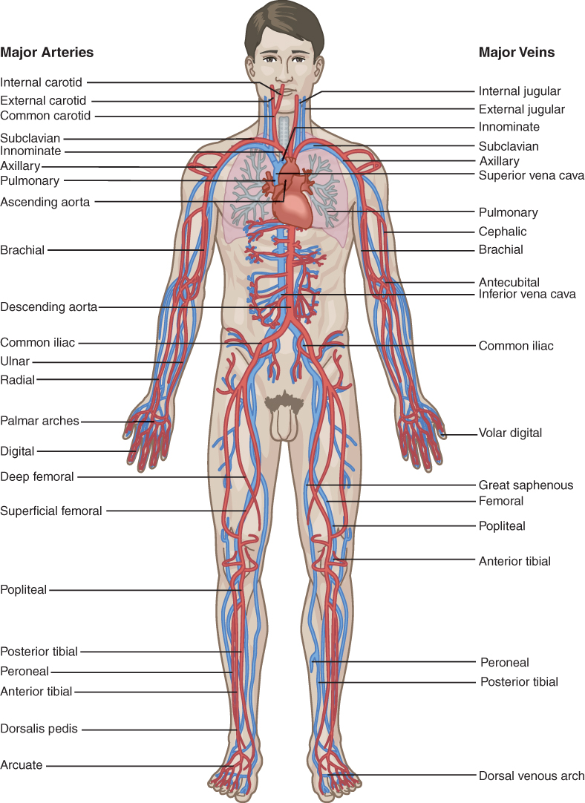
The Circulatory System (3 of 3)
© Jones & Bartlett Learning.

Slide 11
When Body Systems Fail
Without oxygen, brain cells begin to die in 4 to 6 minutes.
Until advanced care is available, CPR should
Supply oxygen to the blood
Keep the blood flowing to the brain

Slide 12
Respiratory System Failure
Signs and symptoms of respiratory distress:
Signs of hypoxia
Signs of airway obstruction
Flared nostrils
Rapid, deep, or irregular breathing
Straining to breathe
Cyanosis of fingernails and around lips
Respiratory arrest is the most severe sign of respiratory system failure.

Slide 13
Circulatory System Failure
Angina
Heart is temporarily deprived of oxygen due to partial narrowing of a coronary artery.
Acute myocardial infarction (heart attack)
Severe or prolonged interruption of blood flow
Collectively known as “acute coronary syndrome (ACS)”
Chest pain, pressure, or discomfort is the most common symptom.

Slide 14
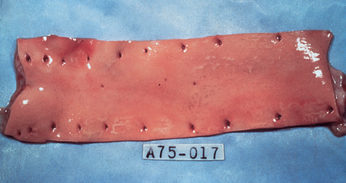
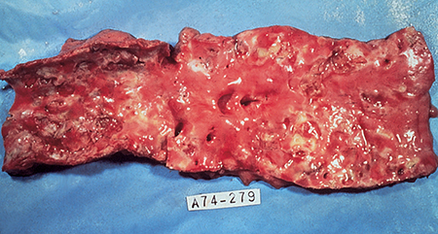
Acute Myocardial Infarction (AMI) (1 of 2)
Signs and symptoms include
Radiating chest pain
Dyspnea
Diaphoresis
© American Academy of Orthopaedic Surgeons.
© American Academy of Orthopaedic Surgeons.

Slide 15
Acute Myocardial Infarction (AMI) (2 of 2)
Nausea or vomiting
Irregular pulse
Weakness
Cool, pale, moist skin
Not all signs and symptoms are present in all cases.
Angioplasty or fibrinolytics may relieve blockage.

Slide 16
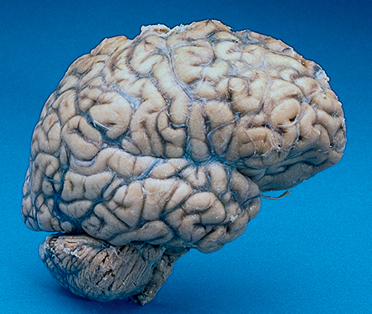
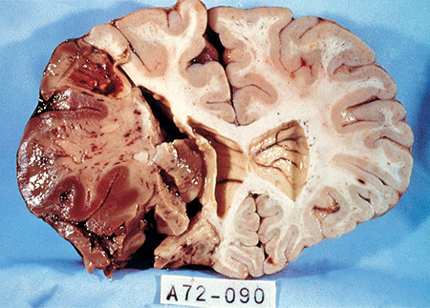
Stroke (1 of 3)
Ischemic
A blood vessel in the brain becomes occluded.
Hemorrhagic
A blood vessel ruptures.
Effects are often permanent.
© American Academy of Orthopaedic Surgeons.
© American Academy of Orthopaedic Surgeons.

Slide 17
Stroke (2 of 3)
Signs and symptoms include
Weakness, numbness, paralysis to one side
Blurred or decreased vision
Problems speaking or understanding speech
Dizziness, loss of balance
Severe, sudden, and unexplained headache
Unequal pupils

Slide 18
Stroke (3 of 3)
Use stroke assessment tools.
Develop plans in advance for management of patients with acute stroke.
© Jones & Bartlett Learning.

