Slide 1
Chapter 4
Basic Life Support for Adults and Children

Slide 2
Patient Assessment (1 of 2)
Begin your primary assessment of a motionless patient by checking responsiveness.
Roll an unresponsive patient who is lying
facedown.
Tap the patient on the shoulder and shout, “Are you okay?”
If the patient is unresponsive, call for help.
© Jones & Bartlett Learning. Courtesy of MIEMSS.

Slide 3
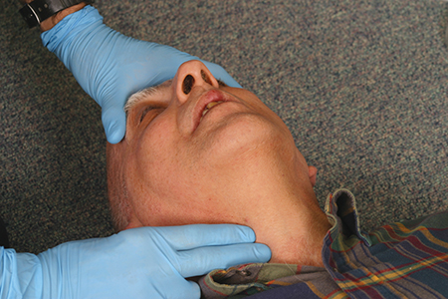
Patient Assessment (2 of 2)
Check an unresponsive patient for breathing (visualizing chest rise) and a pulse (at the carotid artery).
This will determine whether you should perform rescue breathing or CPR.
© Jones & Bartlett Learning. Courtesy of MIEMSS.

Slide 4
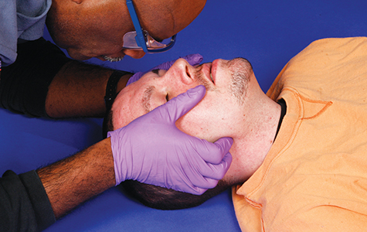
Opening the Airway
Open the airway before performing rescue breathing.
Head tilt–chin lift maneuver
Jaw-thrust maneuver (if a spinal injury is suspected)
© Jones & Bartlett Learning. Courtesy of MIEMSS.
© Jones & Bartlett Learning. Courtesy of MIEMSS.

Slide 5
Providing Rescue Breathing (1 of 2)
Blow air into the lungs of an apneic patient.
Continue to breathe for the patient if a pulse is present but he or she is not breathing.
One breath every 3 to 5 seconds for children ages 1 to the onset of puberty
One breath every 5 to 6 seconds for adults

Slide 6
Providing Rescue Breathing (2 of 2)
Deliver just enough air to produce chest rise.
Do not ventilate too fast or with too much volume
If the chest does not rise, reposition the head and attempt to deliver another breath.
If two attempts are unsuccessful, suspect an airway obstruction.

Slide 7
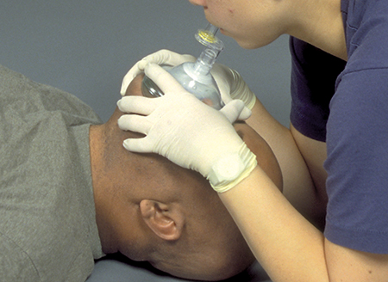
Methods for Performing Rescue Breathing
Mouth-to-mask
Mask-to-stoma
© Jones & Bartlett Learning. Courtesy of MIEMSS.
© Jones & Bartlett Learning. Courtesy of MIEMSS.

Slide 8
Performing CPR
CPR is a combination of chest compressions and rescue breaths.
Begin CPR with chest compressions.
Continue until a defibrillator is available.
Indicated in:
An unresponsive patient who is not breathing (or has agonal gasps)
An unresponsive, nonbreathing child with no pulse or a pulse of less than 60 beats per minute with signs of poor perfusion

Slide 9
Adult CPR (1 of 3)
Position yourself and the patient.
Place the heel of one hand in the center of the chest, between the nipples.
Place your other hand on top of the first and lock your fingers together.

Slide 10
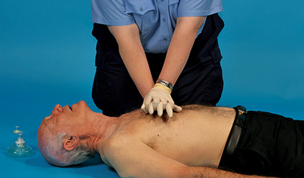
Adult CPR (2 of 3)
Lean forward so that your shoulders are directly over your hands and the patient’s sternum. Keep your arms straight.
© Jones & Bartlett Learning. Courtesy of MIEMSS.

Slide 11
Adult CPR (3 of 3)
Compress the sternum at least 2 inches (5 cm) (no more than 2.4 inches [6 cm]).
Sets of 30 compressions
At a rate of 100 to 120 compressions/min
Give 2 breaths.
Ensure chest rise
Continue cycles until defibrillator arrives or patient moves.

Slide 12
Child CPR (1 of 3)
Position yourself and the patient.
Place the heel of one hand in the center of the chest, between the nipples.
For larger children, use two hands.

Slide 13
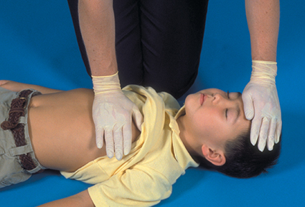
Child CPR (2 of 3)
Lean forward so your shoulders are directly over your hand(s) and the patient’s sternum. Keep your arms straight.
© Jones & Bartlett Learning. Courtesy of MIEMSS.

Slide 14
Child CPR (3 of 3)
Compress the sternum at least one third the anteroposterior depth of the chest.
Sets of 30 compressions
At a rate of 100 to 120 compressions/min
Give 2 breaths.
Ensure chest rise.
Continue cycles until defibrillator arrives or patient moves.

Slide 15
Two-Person CPR (1 of 3)
One provider performs CPR; one provider delivers rescue breaths.
Adults: 30-to-2 compression-to-ventilation ratio
Children: 15-to-2 compression-to-ventilation ratio

Slide 16
Two-Person CPR (2 of 3)
Switch functions every 2 minutes.
Do not interrupt compressions for more than 5 seconds.
© Jones & Bartlett Learning. Courtesy of MIEMSS.

Slide 17
Two-Person CPR (3 of 3)
Advanced airways
Do not deliver cycles.
Ventilate at a rate of 10 breaths a minute.
Perform continuous chest compressions at a rate of 100 to 120 per minute.
Do not pause compressions to deliver breaths.

Slide 18
Stopping CPR
Return of spontaneous circulation occurs
Replaced by other trained rescuer
Physician tells you to stop
You are too exhausted to continue
The scene becomes unsafe
Cardiac arrest lasts longer than 30 minutes
Except with severe hypothermia or cold water drowning

Slide 19
CPR Complications and Errors (1 of 2)
Complications include:
Fractures
Rib cartilage separation
Bruising of heart and lungs
Punctures
Ruptured lungs

Slide 20
CPR Complications and Errors (2 of 2)
Errors include:
Failing to adequately open the airway
Failing to maintain an open airway
Failing to maintain a good seal
Breathing too fast or forcefully
Completing cycles too slowly or quickly
Performing compressions with poor positioning
Performing compressions that are too shallow or deep

Slide 21
Airway Obstruction (Choking) (1 of 2)
You must be able to quickly distinguish choking from other causes of sudden respiratory failure.
Key to preventing hypoxia, loss of consciousness, and cardiac arrest

Slide 22
Airway Obstruction (Choking) (2 of 2)
Common causes include:
Food
Small objects (in children)
The tongue (in unresponsive patients)
Swelling of the airway passages
If unsure of the cause, assume it is a foreign body.
If you believe swelling is the cause, request ALS personnel.

Slide 23
Mild Airway Obstructions
This patient:
Has adequate air exchange
Can cough forcefully
May be able to speak with difficulty
You should:
Encourage the patient to cough
Not interfere with the patient’s attempts to expel the obstruction
Remain with the patient

Slide 24
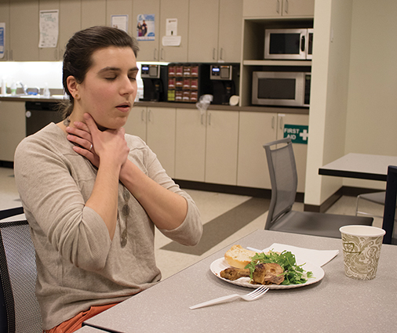
Severe Airway Obstruction
This patient:
Cannot speak, cough, cry, or breathe
May become cyanotic
Will eventually lose consciousness
© Jones & Bartlett Learning.

Slide 25
Managing Airway Obstruction in Responsive Patients
See if the patient can exchange air.
If the patient cannot talk, perform abdominal thrusts (the Heimlich maneuver).
If more than one provider is present, one should summon help.

Slide 26
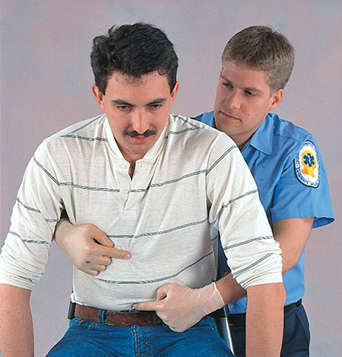
Abdominal Thrusts (1 of 2)
Stand or kneel behind the patient.
Wrap your arms around his or her waist.
Make a fist with one hand.
Place the thumb side against the abdomen.
© Jones & Bartlett Learning. Courtesy of MIEMSS.

Slide 27
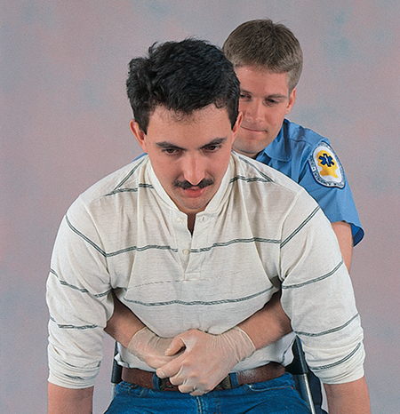
Abdominal Thrusts (2 of 2)
Grasp your fist with your other hand and give quick, inward and upward thrusts into the abdomen.
Continue until the obstruction is relieved or the patient becomes unresponsive.
© Jones & Bartlett Learning. Courtesy of MIEMSS.

Slide 28
Special Situations (1 of 2)
Perform chest thrusts on patients who are:
Obese
In the later stage of pregnancy
© Jones & Bartlett Learning. Courtesy of MIEMSS.

Slide 29
Special Situations (1 of 2)
To perform chest thrusts:
Stand behind the patient with your arms under the patient’s armpits.
Wrap your arms around the chest.
Place the thumb side of one hand in the middle of the chest.
Grasp the fist with your other hand and pull inward on the chest.

Slide 30
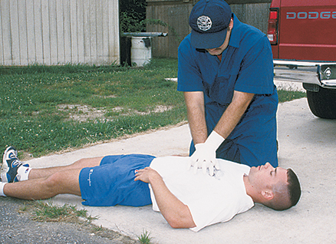
Managing Airway Obstruction in Unresponsive Patients (1 of 3)
If a patient becomes unresponsive during attempts to relieve an obstruction:
Support the patient to the ground.
Call (or send) for help.
Perform chest compressions immediately.
© Jones & Bartlett Learning. Courtesy of MIEMSS.

Slide 31
Managing Airway Obstruction in Unresponsive Patients (2 of 3)
Unresponsive patient (cont’d):
Open the airway and look inside the mouth.
If there is an object in the mouth, remove it.
If there is no object, resume chest compressions.

Slide 32
Managing Airway Obstruction in Unresponsive Patients (3 of 3)
Continue until obstruction is relieved or ALS arrives.
After 2 minutes of CPR, go for help if someone has not already done so.
Once obstruction is relieved and your breaths produce visible chest rise, check for a pulse.
If no pulse, continue CPR until help arrives.

