Slide 1
Chapter 6
Resuscitation Adjuncts

Slide 2
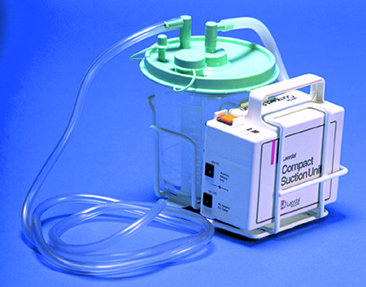
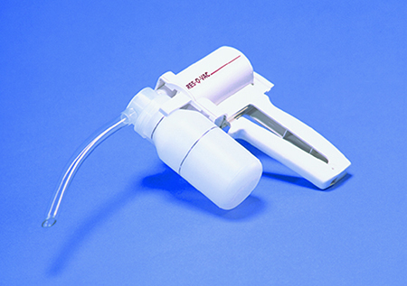
Suction Units
Prevent secretions from obstructing the airway or being aspirated.
© Jones & Bartlett Learning. Courtesy of MIEMSS.
© Jones & Bartlett Learning. Courtesy of MIEMSS.

Slide 3
Suctioning
Turn the patient’s head to the side. Take proper precautions if you suspect spinal injury.
Open the patient’s mouth to remove large debris.
Measure depth of insertion.
Suction while withdrawing the suction catheter.

Slide 4
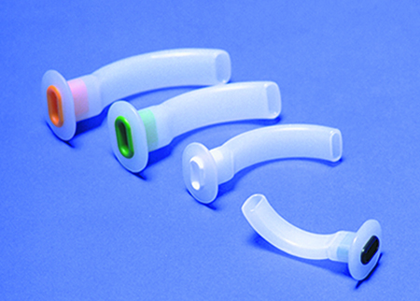
Oral Airways
Artificial airways can be inserted to keep the tongue from blocking the airway.
Use oral airways on unconscious patients only.
© Jones & Bartlett Learning. Courtesy of MIEMSS.

Slide 5
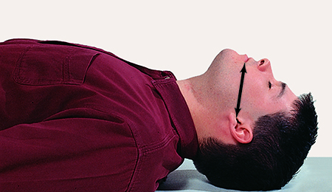
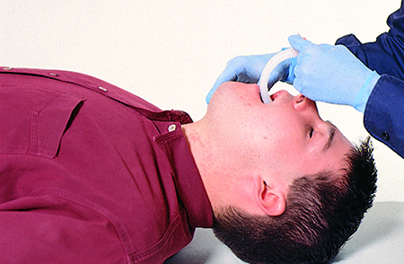
Inserting an Oral Airway (1 of 2)
Choose the correct size.
Open the patient’s airway.
Insert the airway along the roof of the mouth, with the curved tip pointing toward the roof of the mouth.
© Jones & Bartlett Learning. Courtesy of MIEMSS.
© Jones & Bartlett Learning. Courtesy of MIEMSS.

Slide 6
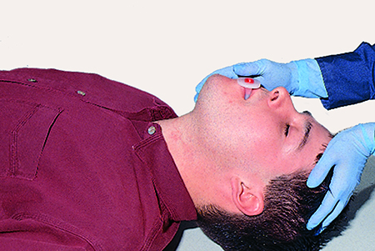
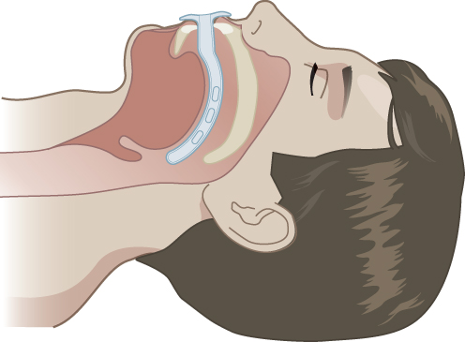
Inserting an Oral Airway (2 of 2)
As the tip approaches the back of the throat, rotate the airway 180°so the tip points toward the chest.
The flange should rest against the patient’s lips.
© Jones & Bartlett Learning. Courtesy of MIEMSS.
© Jones & Bartlett Learning.

Slide 7
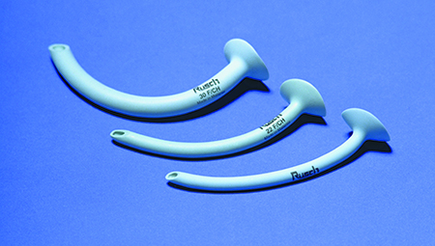
Nasal Airways
Use on semiconscious or conscious patients, or patients with a gag reflex.
Do not use on patients with suspected fractures in the skull, nose, or midface.
© Jones & Bartlett Learning. Courtesy of MIEMSS.

Slide 8
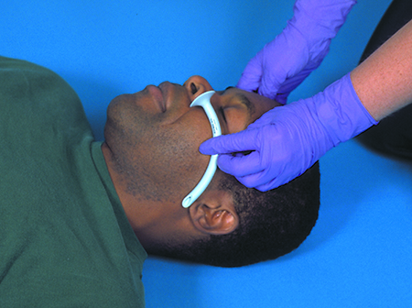
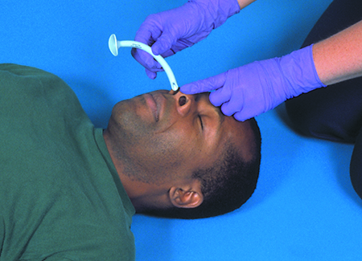
Inserting a Nasal Airway (1 of 2)
Choose the right size.
Open the patient’s airway.
Lubricate the airway.
Insert the airway through the nostril, following the nasal passage straight back.
© Jones & Bartlett Learning. Courtesy of MIEMSS.
© Jones & Bartlett Learning. Courtesy of MIEMSS.

Slide 9
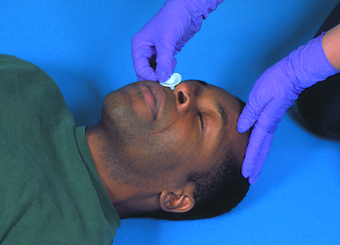
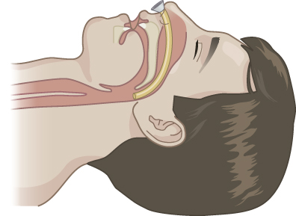
Inserting a Nasal Airway (2 of 2)
Do not force the airway if you meet resistance.
Listen and feel for airflow through the airway.
© Jones & Bartlett Learning. Courtesy of MIEMSS.
© Jones & Bartlett Learning. Courtesy of MIEMSS.

Slide 10
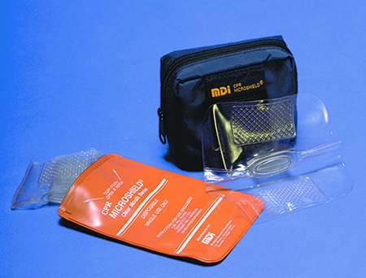
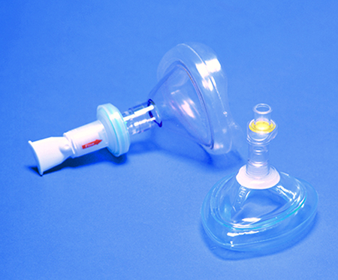
Ventilation Devices
The mask must:
Fit well
Have a one-way valve
Be made of transparent material
Be available in infant, child, and adult sizes
© Jones & Bartlett Learning. Courtesy of MIEMSS.
© Jones & Bartlett Learning. Courtesy of MIEMSS.

Slide 11
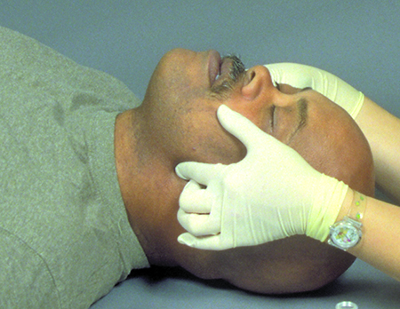
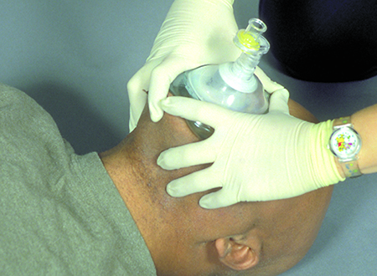
Mouth-to-Mask Rescue Breathing
Position yourself at the patient’s head.
Open the airway.
Create a good seal over the mouth and nose.
Perform rescue breathing.
© Jones & Bartlett Learning.
© Jones & Bartlett Learning.

Slide 12
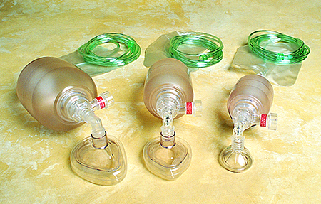
Bag-Valve-Mask (1 of 2)
Can be used with an oral or nasal airway
Delivers a higher concentration of oxygen than a ventilation mask alone
Practice regularly.
© American Academy of Orthopaedic Surgeons.

Slide 13
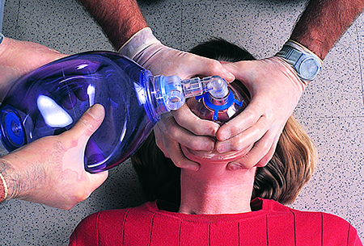
Bag-Valve-Mask (2 of 2)
Most effective when used by two providers.
One maintains an open airway and mask-to-face seal
One squeezes the bag
Bag compressions and rescue breathing should be smooth, not forceful.
© Jones & Bartlett Learning. Courtesy of MIEMSS.

Slide 14
Rescue Airway Devices
Advantages
Blind insertion
No mask seal is needed
Offers some protection from aspiration
Disadvantages
Ineffective if the cuff malfunctions
Require assessment of lung sounds
Cannot be used on all patients
May not come in pediatric sizes

Slide 15
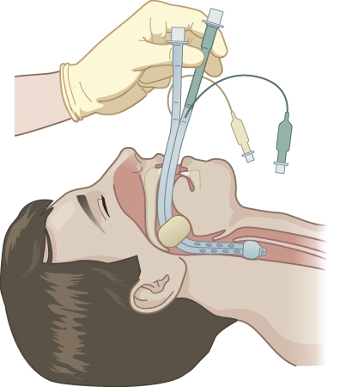
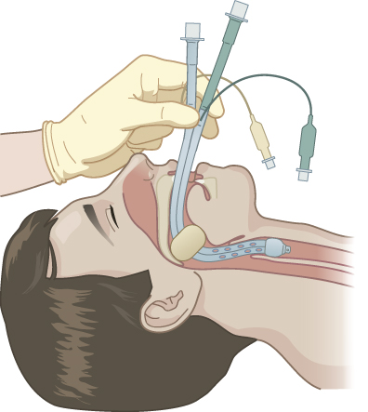
Esophageal Tracheal Combitube (ETC)
Double-lumen tube
Blue (#1) lumen
Primary ventilation
Used if inserted into the esophagus
Clear (#2) lumen
Secondary ventilation
Used if inserted into the trachea
© Jones & Bartlett Learning.
© Jones & Bartlett Learning.

Slide 16
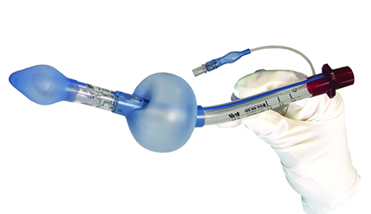
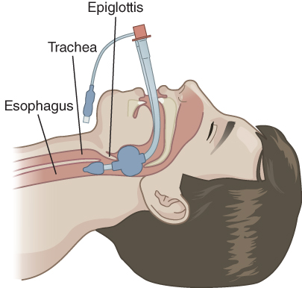
King LT
Single-lumen airway
Blindly inserted into the esophagus
Curved tube with ventilation ports between two inflatable cuffs
Courtesy of King Systems.
© Jones & Bartlett Learning.

Slide 17
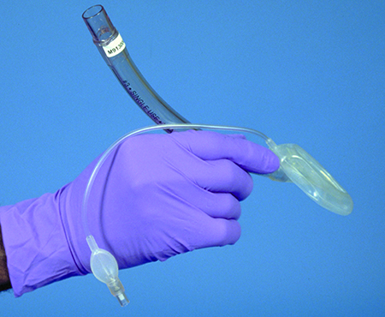
Laryngeal Mask Airway (LMA)
Single-lumen
Mask-like cuff protects the airway
Blocks esophagus
Allows air to enter the trachea only
© Jones & Bartlett Learning. Courtesy of MIEMSS.

Slide 18
Endotracheal Intubation
Should not interrupt chest compressions
Once advanced airway device is in place:
Deliver continuous compressions (100 to 120/min) and ventilations (10/min).
Do not attempt to synchronize compressions and ventilations.
Do not pause compressions to deliver a ventilation.

Slide 19
Confirmation of Advanced Airway Placement
When an advanced airway is placed:
Visualize chest rise.
Verify bilateral lung sounds.
Confirm the absence of sounds over the epigastrium.
Perform quantitative waveform capnography.

Slide 20
Impedance Threshold Device (ITD) (1 of 2)
Device placed between the ET tube and a BVM.
Designed to limit the air from entering the lungs during the recoil phase between chest compressions.
Improves cardiac filling and circulation

Slide 21
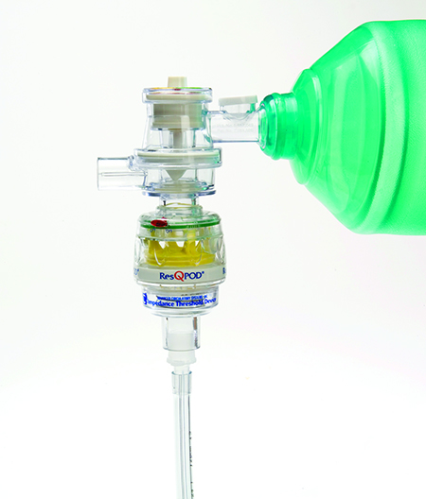
Impedance Threshold Device (ITD) (2 of 2)
Must be removed if return of spontaneous circulation occurs
Courtesy of Advanced Circulatory.

Slide 22
Active Compression–Decompression CPR (1 of 2)
Involves compressing the chest and actively pulling it back up to its neutral position or beyond (decompression)
May increase the amount of blood that returns to the heart
Features a suction cup placed in the center of the chest

Slide 23
Active Compression–Decompression CPR (2 of 2)
After compressing the chest, the rescuer pulls up on the handle of the device
Provides active decompression of the chest
Ensures that the chest returns to at least its neutral position

Slide 24
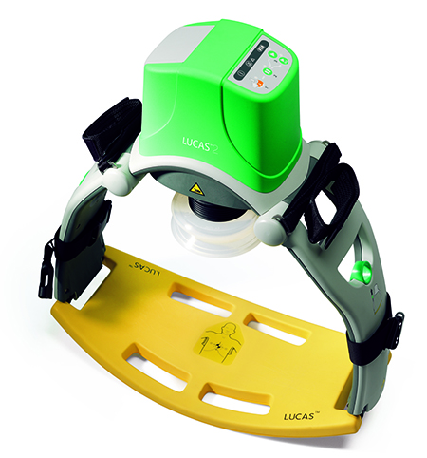
Mechanical CPR Device
Beneficial when personnel are limited
Courtesy of LUCAS CPR (Physio Control Inc.).

Slide 25
Automated External Defibrillation (1 of 2)
The most important factors for surviving SCA are CPR and early defibrillation.
Defibrillation
Direct electrical current is passed through the heart
Momentarily stops all electrical activity
Attempts to restart the heart with a normal rhythm

Slide 26
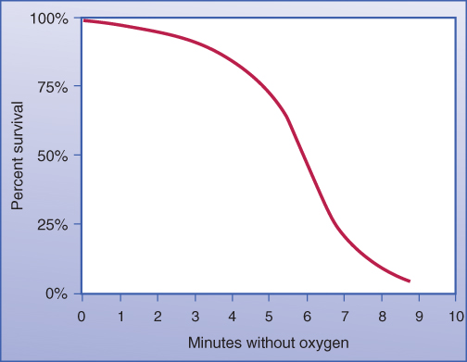
Automated External Defibrillation (2 of 2)
Each minute that V-fib persists, the patient’s chance of survival decreases.
After 8 to 10 minutes, survival is unlikely.
© Jones & Bartlett Learning.

Slide 27
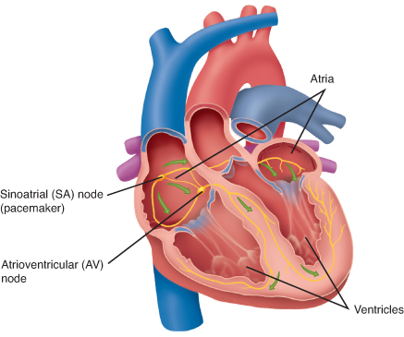
The Heart’s Electrical Conduction System
The SA node sends signals to the AV node.
When the impulse reaches the Purkinje fibers, ventricular contractions result in a pulse.
© Jones & Bartlett Learning.

Slide 28
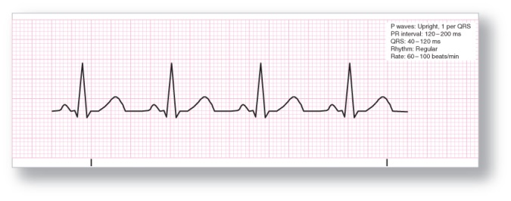
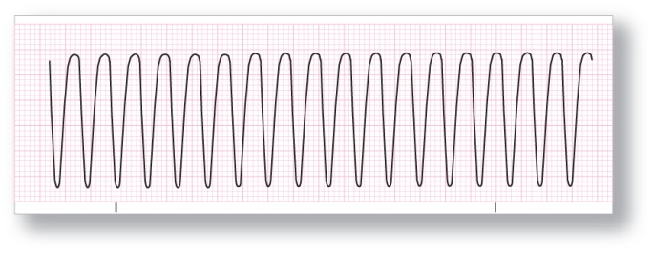
Abnormal Electrical Activity
Normal ECG tracing
Ventricular fibrillation
Ventricular tachycardia
Adapted from Arrhythmia Recognition: The Art of Interpretation, courtesy of Tomas B. Garcia, MD.
Adapted from 12-Lead ECG: The Art of Interpretation, courtesy of Tomas B. Garcia, MD.
Adapted from Arrhythmia Recognition: The Art of Interpretation, courtesy of Tomas B. Garcia, MD.

Slide 29
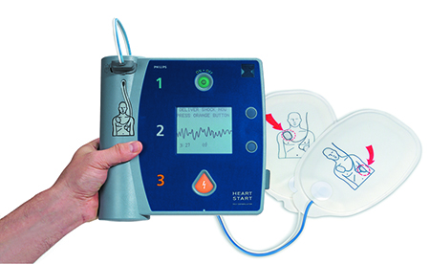
Automated External Defibrillators (AEDs)
An AED is applied ONLY to a patient in cardiac arrest
Unresponsive
Not breathing
Pulseless
© Jones & Bartlett Learning. Courtesy of MIEMSS.

Slide 30
AED Operation (1 of 5)
Confirm that the patient is in cardiac arrest.
Begin CPR with chest compressions.
Apply the AED as soon as it is available.
Turn the equipment on.
Expose the patient’s chest and ensure that the skin is clean and dry.

Slide 31
AED Operation (2 of 5)
Apply the AED pads to the victim’s bare chest and the cable to the AED.
Do not interrupt chest compressions when applying the AED pads.
Make sure no one is touching the patient while the AED analyzes the heart rhythm.
If the patient is in V-fib or V-tach, the AED will recommend defibrillation.

Slide 32
AED Operation (3 of 5)
If the AED advises a shock, continue CPR while the defibrillator is charging.
Ensure that no one is touching the patient.
Deliver the shock.

Slide 33
AED Operation (4 of 5)
After defibrillation, resume CPR starting with chest compressions.
Perform CPR for 2 minutes, then reanalyze the rhythm.
Repeat the analysis, shock, and CPR steps until ALS personnel arrive or the patient starts to move.

Slide 34
AED Operation (5 of 5)
The AED will give an error warning if the cables or pads are not secure.
AEDs cannot be used in moving vehicles.
Patients in cardiac arrest who do not respond to defibrillation or receive the “No shock advised” message need ALS measures.

Slide 35
AED Precautions (1 of 2)
Do not use alcohol to wipe the patient’s chest.
Do not apply the pads directly over medication patches.
Place the pads at least 1 inch (3 cm) away from implantable pacemakers.
© BSIP/Science Source

Slide 36
AED Precautions (2 of 2)
Do not defibrillate a patient who is lying on a surface likely to conduct electricity.
Do not shock or analyze the rhythm until everyone is clear of the patient.

Slide 37
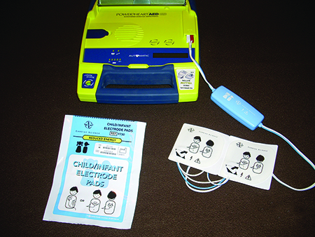
AED Use in Children (1 of 3)
Can be used in patients under 8 years of age using pediatric-sized pads and a dose-attenuating system.
If unavailable, use adult AED pads.
© Cardiac Science Corporation

Slide 38
AED Use in Children (2 of 3)
Should be applied:
After the first five cycles of CPR
Or, if an otherwise healthy infant or child suddenly collapses
After first five cycles of CPR, use AED in same manner as for an adult

Slide 39
AED Use in Children (3 of 3)
In infants, a manual defibrillator is preferred.
This is an ALS skill; request ALS support immediately.
If not available, use pediatric pads with a dose attenuator.
If neither is available, use adult AED pads.

Slide 40
AED Maintenance
Inspect your AED regularly.
Check expiration dates on pads and batteries.
Document inspections.

