Slide 1
Narcan
Naloxone, sold under the brand name Narcan among others, is an opioid antagonist, a medication used to reverse or reduce the effects of opioids. For example, it is used to restore breathing after an opioid overdose. Effects begin within two minutes

Slide 2
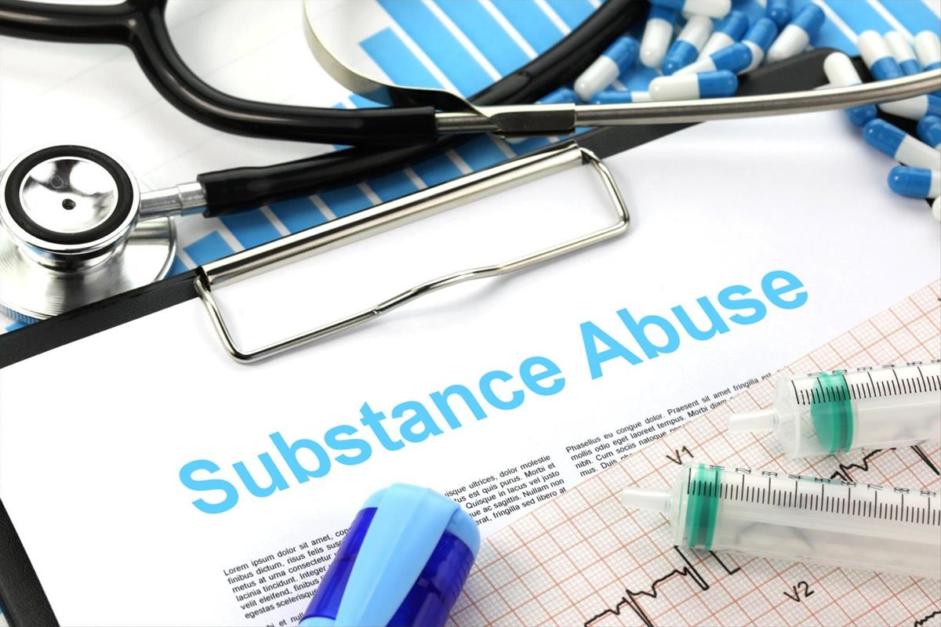
Substance Abuse
Substance Use Disorder
Warning Signs
Physical Signs
Physical warning signs include small pupils; decreased respiratory rate; non-responsiveness; drowsy, loss or increase in appetite; weight loss or weight gain; Intense flu-like symptoms; and wearing long-sleeves or hiding arms.
Behavioral Signs
Behavioral changes in attitude and/or personality such as as tendency to avoid contact with family and/or friends; change in friends, hobbies, activities and/or sports; drops in performance at work or school; isolation and secretive behavior; as well as moodiness, irritability, nervousness, giddiness
Advanced Signs
Advanced signs of addiction include missing medication; burnt or missing spoons and/or bottle caps, syringes; small bags with powder residue; and missing s

Slide 3
Overdose Signs
Sedation
Improper Breathing
Pin Point Pupils
Loss Consciousness
Foaming of Mouth
This Photo by Unknown Author is licensed under CC BY

Slide 4
Treatment
Give Narcan
Move to Recovery position

