Slide 1
Chapter 3
Patient Assessment

Slide 2
Assessing the Emergency Scene
Evaluate the scene for hazards.
Check for causes of the patient’s condition.
Gain control of the situation.
Determine the need for additional resources.

Slide 3
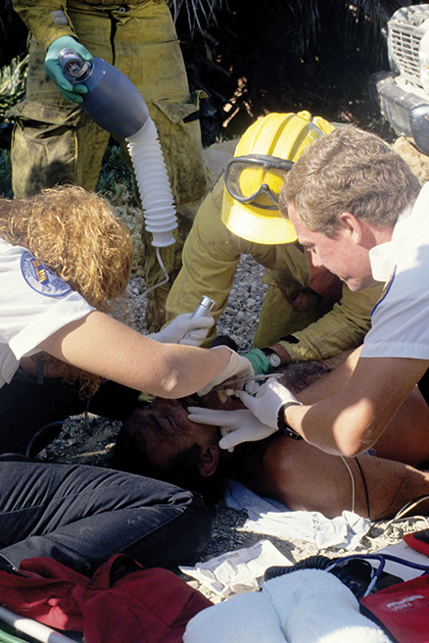
Assessing the Patient
Take standard precautions.
Use the primary assessment format to identify immediate life threats.
© Keith D. Cullom/www.fire-image.com.

Slide 4
Assessing Responsiveness
If the patient is unresponsive
Call for help and proceed with your assessment
© Jones & Bartlett Learning. Courtesy of MIEMSS.

Slide 5
Assessing Breathing and Circulation (1 of 2)
If the patient is unresponsive, simultaneously check for signs of breathing and for a pulse.
Take no longer than 10 seconds.
Check for breathing by looking at the patient’s chest and observing for visible movement.
© Jones & Bartlett Learning. Courtesy of MIEMSS.

Slide 6
Assessing Breathing and Circulation (2 of 2)
Assess pulse in an unresponsive patient who is not breathing:
Carotid pulse for adults and children
Brachial pulse for infants
© Jones & Bartlett Learning. Courtesy of MIEMSS.

Slide 7
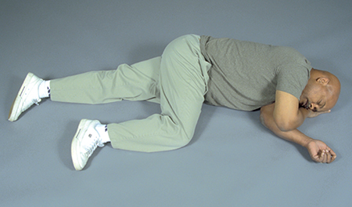
Recovery Position
If the patient is unresponsive; breathing adequately; and not suspected of having injury to the spine, hips, or pelvis:
Place the patient in the recovery position.
Monitor the patient’s condition.
Wait for help to arrive.
© Jones & Bartlett Learning. Courtesy of MIEMSS.

Slide 8
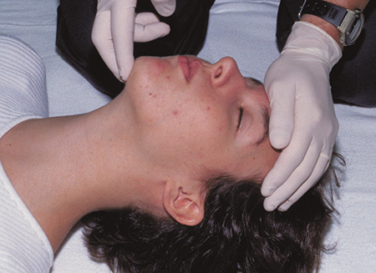
Patients in Respiratory Arrest (1 of 2)
Patient:
Is not breathing (or has only agonal gasps)
Has a pulse
Is not suspected of having a spinal injury
Open the airway.
Use the head tilt-chin lift maneuver.
© Jones & Bartlett Learning. Courtesy of MIEMSS.

Slide 9
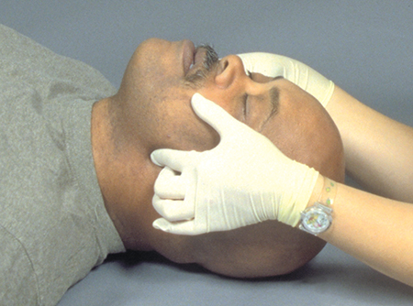
Patients in Respiratory Arrest (2 of 2)
If a spinal injury is suspected, use the jaw-thrust maneuver to open the airway.
Carefully use the head tilt-chin lift maneuver if this is unsuccessful.
© Jones & Bartlett Learning. Courtesy of MIEMSS.

Slide 10
Patients in Cardiopulmonary Arrest
If the patient is not breathing (or has only agonal gasps) and does not have a pulse:
Perform 30 chest compressions.
Open the airway.
Give 2 rescue breaths.
Repeat compressions and rescue breaths until a defibrillator is available.

