Slide 1
Chapter 1
Emergency Cardiac Care and the Health Care Provider

Slide 2
Health Care Providers as Rescuers
Provide basic life support (BLS) as initial care
© Jones & Bartlett Learning. Courtesy of MIEMSS.

Slide 3
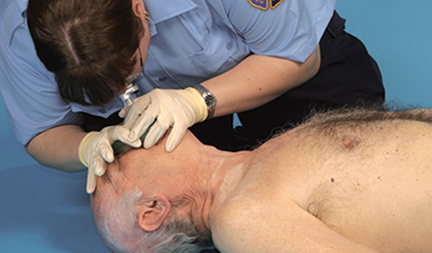
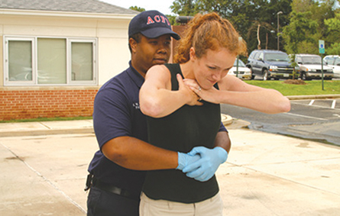
Basic Life Support
Rescue breathing
Cardiopulmonary resuscitation (CPR)
Heimlich maneuver
© Jones & Bartlett Learning. Courtesy of MIEMSS.
© Jones & Bartlett Learning. Courtesy of MIEMSS.
© Jones & Bartlett Learning. Courtesy of MIEMSS.

Slide 4
Preparing for Emergencies
You will need to be physically and mentally prepared for an emergency.
Be physically fit.
Be mentally prepared for challenges.
Periodically review your skills.
Practice with equipment and supplies.
Stay up-to-date on changes in CPR techniques and advances in care.
Be prepared for personal risk.

Slide 5
Disease Transmission and Precautions (1 of 2)
Diseases may be airborne or blood-borne.
Diseases of concern
Hepatitis B and hepatitis C
Human immunodeficiency virus (HIV)
Tuberculosis (TB)

Slide 6
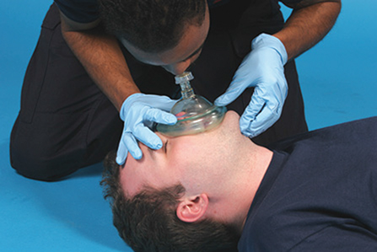
Disease Transmission and Precautions (2 of 2)
Protection
Standard precautions with personal protective equipment (PPE)
Vaccinations
© Jones & Bartlett Learning. Courtesy of MIEMSS.

Slide 7
Cardiovascular Disease (CVD)
Spectrum of diseases
Accounts for one in three (approximately 800,000) deaths a year
Health care providers should reduce their personal risk factors.

Slide 8
Risk Factors of CVD
Avoidable
Smoking
High blood pressure
High cholesterol
Lack of exercise
Stress
Obesity
Unavoidable
Gender
Aging
Heredity

Slide 9
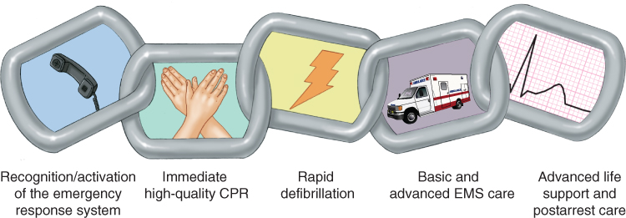
Chain of Survival (1 of 2)
The chain of survival can help reduce the number of deaths from SCA.
Separate chains of survival have been identified for the following two settings:
Out-of-hospital cardiac arrest (OHCA)
© Jones & Bartlett Learning. Data from American Heart Association.

Slide 10
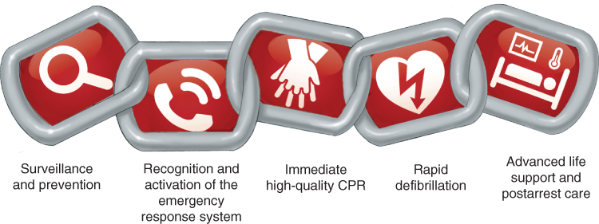
Chain of Survival (2 of 2)
In-hospital cardiac arrest (IHCA)
Modified from 2015 American Heart Association Guidelines: Update for CPR and ECC. Part 4: Systems of Care & Continuous Quality Improvement. Circulation. 2015; 132:S397–S413. ©2015, American Heart Association, Inc.

Slide 11
Early Warning Signs of a Heart Attack
Chest discomfort
Burning sensation in chest or throat
Radiating pain in left arm, shoulders, jaw, neck, or back

Slide 12
ACT WISELY (1 of 2)
Acknowledge there is a problem.
Calmly assess the situation and encourage the person to get help.
Tenacity. Be persistent.
Willingness. Be willing to act.
Influence.

Slide 13
ACT WISELY (2 of 2)
Simplify the discussion.
Empathy.
Link the person to the nearest hospital.
“Yes, I will get help!”

Slide 14
Legal and Ethical Considerations (1 of 2)
Duty to act
Standard of care
Consent
Advance directives
Withholding or discontinuing CPR
Emotional support
Good Samaritan laws

Slide 15
Legal and Ethical Considerations (2 of 2)
Courtesy of Texas Department of State Health Services.

