Slide 1
Chapter 5
Basic Life Support for Infants

Slide 2
Basic Life Support for Infants
Cardiac arrest in infants usually results from respiratory failure.
Causes include:
Injury
Suffocation
Airway obstruction
Smoke inhalation
Infection
Drowning
Sudden infant death syndrome (SIDS)

Slide 3
Primary Assessment of a Motionless Infant
Check for responsiveness.
If responsive, assist him or her if needed.
If unresponsive, quickly check the chest visually for movement and check for a brachial pulse.
If pulse is present, provide rescue breathing.
If pulse is absent or less than 60 beats/min with poor perfusion, begin CPR, starting with chest compressions.

Slide 4
Opening the Airway
Perform rescue breathing in an unresponsive infant who:
Has a pulse
Is not breathing or has agonal gasps
Use the head tilt–chin lift maneuver unless you suspect a spinal injury.
© wellphoto/Shutterstock.

Slide 5
Providing Rescue Breathing (1 of 2)
Create a tight seal over the infant’s mouth with a mask or other barrier device.
Gently blow into the infant’s mouth and nose.
Watch for chest rise and fall.
Provide rescue breathing at a rate of 12 to 20 breaths per minute.

Slide 6
Providing Rescue Breathing (2 of 2)
Avoid hyperventilation by:
Maintaining an open airway
Giving just enough air to produce visible chest rise
If the chest does not rise, reposition the head and attempt to deliver another breath.
If unsuccessful, suspect an airway obstruction.

Slide 7
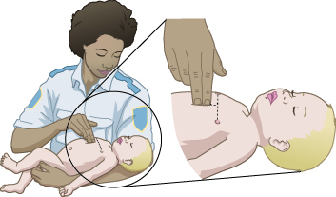
CPR for Infants (1 of 4)
Indicated for an infant who:
Is pulseless or
Has a heart rate less than 60 beats per minute with signs of poor perfusion
Use two fingers to perform chest compressions.
© Jones & Bartlett Learning.

Slide 8
CPR for Infants (2 of 4)
Compress the chest at least one third of the anteroposterior depth of the chest.
Using the pads of your fingertips
At a rate of 100 to 120 compressions per minute
After 30 chest compressions, open the airway and deliver 2 rescue breaths.

Slide 9
CPR for Infants (3 of 4)
If you are alone:
Give 30 compressions and 2 breaths per cycle.
Perform 2 minutes of CPR, then go for help.
If two health care providers are present:
Give 15 compressions and 2 breaths per cycle.
Switch roles every 2 minutes to minimize fatigue.

Slide 10
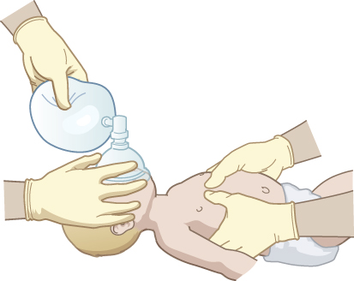
CPR for Infants (4 of 4)
Continue CPR until a defibrillator arrives or the infant starts to move.
Limit interruptions to 10 seconds or less.
When an advanced airway is in place during two-person CPR, do not deliver cycles. Ventilations and compressions should be provided concurrently.
© Jones & Bartlett Learning.

Slide 11
Airway Obstruction in Infants (1 of 2)
Suspect a mild airway obstruction in an infant who:
Is coughing forcefully
Has adequate air exchange
Has normal skin color
Observe, but do not interfere.

Slide 12
Airway Obstruction in Infants (2 of 2)
Suspect a severe airway obstruction in an infant who:
Cannot cough, cry, or breathe
Is coughing weakly
Is cyanotic
Has stridor
Immediate treatment is required.

Slide 13
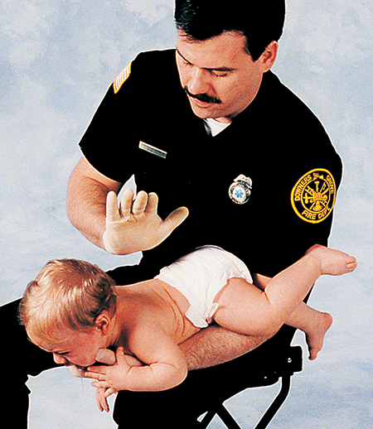
Responsive Infant with an Airway Obstruction (1 of 2)
Position the infant facedown on your forearm.
Lower the infant and your forearm to your thigh.
Deliver five back slaps.
© Jones & Bartlett Learning. Courtesy of MIEMSS.

Slide 14
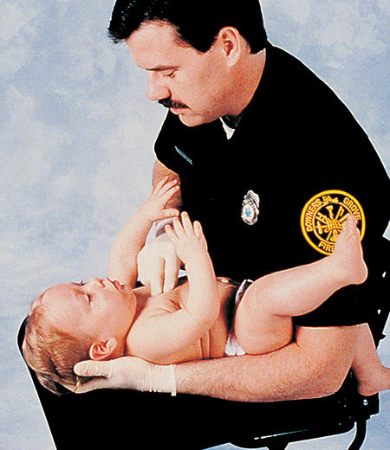
Responsive Infant with an Airway Obstruction (2 of 2)
Turn the infant face up.
Deliver five chest thrusts.
Continue cycles until the object is dislodged or the infant becomes unresponsive.
© Jones & Bartlett Learning. Courtesy of MIEMSS.

Slide 15
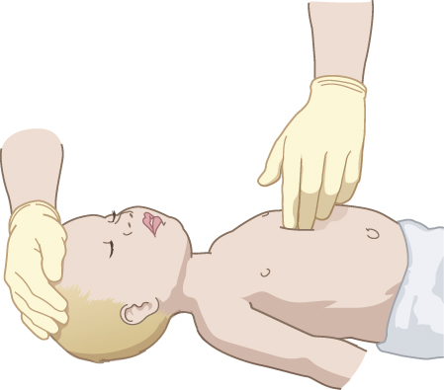
Unresponsive Infant with an Airway Obstruction (1 of 4)
If the infant becomes unresponsive:
Position the infant on a firm, flat surface.
Perform chest compressions.
30 if you are alone
15 if two providers are present
© Jones & Bartlett Learning. Courtesy of MIEMSS.

Slide 16
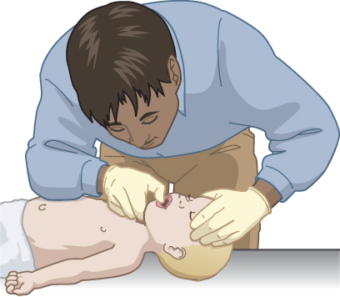
Unresponsive Infant with an Airway Obstruction (2 of 4)
Unresponsive infant (cont’d):
Open the airway and look inside the mouth.
If you see an object and can easily remove it, attempt to remove it with your finger and attempt to ventilate.
If you do not see an object, resume chest compressions.
© Jones & Bartlett Learning.

Slide 17
Unresponsive Infant with an Airway Obstruction (3 of 4)
Continue the sequence of performing chest compressions, opening the airway, and looking inside the mouth until:
The obstruction is relieved or
Advanced life support personnel take over.

Slide 18
Unresponsive Infant with an Airway Obstruction (4 of 4)
If no one has done so, go for help after 2 minutes of CPR.
Once your breaths produce chest rise, check for a pulse.
If the patient has a pulse but is not breathing (or has agonal gasps), continue rescue breathing.
If the patient does not have a pulse, continue CPR until help arrives.

