Slide 1
Chapter 7
Special Resuscitation Situations

Slide 2
Trauma
If the patient is found unconscious, consider a head, neck, or spinal injury.
Care begins with ABCs (airway, breathing, and circulation).
Position the patient carefully.
Open the airway.

Slide 3
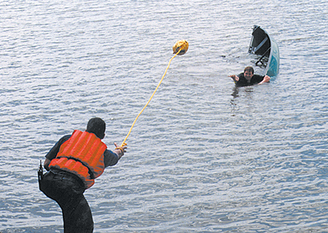
Drowning (1 of 2)
If the person is in the water and is safe, there are four ways to attempt rescue:
Reach
Throw
Row
Go
© American Academy of Orthopaedic Surgeons.

Slide 4
Drowning (2 of 2)
Remove the person from the water.
Attempt resuscitation.
Begin CPR in nonbreathing patient without a pulse.
Provide rescue breathing in patient with a pulse.
If chest does not rise after repositioning of airway, begin airway obstruction removal.

Slide 5
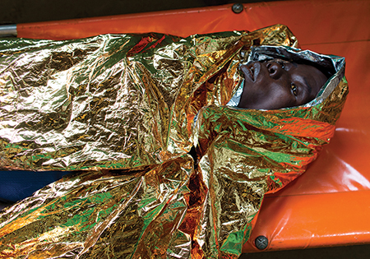
Hypothermia (1 of 2)
Move the patient to a warmer area.
Remove wet clothing.
Cover with layered blankets.
Do not elevate the feet.
© ton koene/Alamy

Slide 6
Hypothermia (2 of 2)
Check breathing and pulse for 30 to 45 seconds before beginning CPR.
If shock is indicated, defibrillate one time with the AED.
Do not shock again until the patient is adequately warmed.

Slide 7
Electrical Shock
Safety is the most important consideration.
Respiratory and cardiac arrest are the primary concerns.
Open the airway with the jaw-thrust maneuver.
Provide rescue breathing for respiratory arrest.
Begin CPR for a patient in cardiac arrest.
External burn wounds are low priority.

Slide 8
Cardiac Arrest in Pregnancy (1 of 2)
Priorities are to provide high-quality CPR and to relieve pressure off the aorta and vena cavae.
If the patient is not in cardiac arrest:
Position her on her left side to relieve pressure on the great vessels.
If the patient is in cardiac arrest:
She must remain in a supine position to maximize the effectiveness of compressions.

Slide 9
Cardiac Arrest in Pregnancy (2 of 2)
If the top of the patient’s uterus (fundus) can be felt at or above the level of the umbilicus, perform manual displacement of the uterus to the left.
© Jones & Bartlett Learning.

Slide 10
Opioid Overdose
An opioid can depress the central nervous system and cause respiratory and cardiac arrest.
Bystanders may have administered the antidote naloxone (Narcan).
Determine how much and by which route
Standard resuscitative measures take priority over naloxone administration.

